Slide 1
Breaking Data Silos for Collaboration From Big Data to Fast Data
Michele Francis Padayachee, GS1 South Africa
September 2025
Notes:
Good afternoon, everyone! I don’t know about you, but I’m very happy to be surrounded by people who actually get excited about data. You know you’re in the right room when words like ‘interoperability’ and ‘trusted identification’ make people smile! Today we’re unpacking how to move from big data — which sometimes feels a bit overwhelming — to fast, trusted, actionable data that drives collaboration and innovation

Slide 2
GS1 Vision 2030
Powering trust in data
for everyone everywhere
Unique strategic benefits
Trusted data
Innovative standards & services to enhance trusted identification and trusted data
Collaboration
Collaboration platform to inspire common solutions by and for industry and society
Interoperability
Interoperability across industries, stakeholders and geographies
Notes:
“At GS1, our Vision 2030 is about powering trust in data for everyone, everywhere. This isn’t just a slogan — it’s a roadmap for how we enable organisations to move from siloed, fragmented systems toward fast, interoperable, and trusted data ecosystems.”
That one line directly ties GS1 Vision 2030 to the theme of breaking data silos.
🔹 2. Aligning the Three GS1 Pillars to the Panel Theme
1. Trusted Data → From Big Data to Fast, Reliable Data
“As organisations race toward fast data, trust becomes the differentiator. GS1’s standards create the backbone for trusted identification — ensuring that data consumed by AI, analytics, and automation is accurate, verified, and interoperable.”
👉 Relevance: Big data is useless if it’s not trusted. GS1 turns “big” into “fast and reliable.”
2. Collaboration → Breaking Data Silos
“GS1 exists to bring industries together around a shared language of business. Collaboration is at the heart of breaking data silos — not just sharing data, but sharing understanding, so that every partner in the ecosystem can move faster and make decisions with confidence.”
👉 Relevance: Collaboration isn’t only technical — it’s human and structural. This resonates with the leadership focus of the panel.
3. Interoperability → Driving Agility and Innovation
“True interoperability allows data to flow seamlessly across industries, systems, and geographies. That’s how we move from isolated insights to real-time action — enabling organisations to be more agile, resilient, and future-ready.”
👉 Relevance: “Fast data” is achieved through interoperability — GS1’s core strength.
🔹 3. Vision 2030 as the Future-Focused Bridge
Close your link by bringing it back to Vision 2030’s forward-looking tone:
“Vision 2030 is really about preparing for what’s next — an AI-driven world where trust, collaboration, and interoperability define success. GS1’s role is to ensure that as data accelerates, it also remains grounded in truth.”
🔹 4. Optional Summary Phrase (for Panel Integration)
If Dylan asks you to build on another panellist’s point, you could use:
“What we’re hearing across the table — whether it’s about AI or analytics — all points back to the same challenge: trust. GS1’s vision is to make trusted, fast data the foundation for every collaboration.”

Slide 3
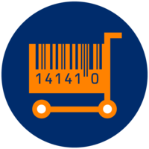
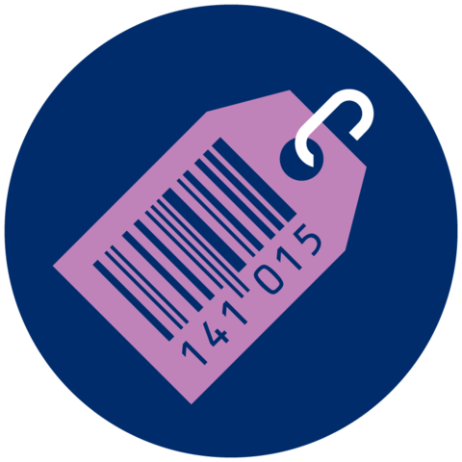
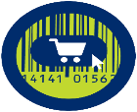



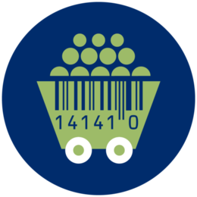

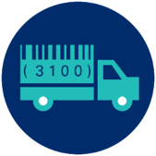
Accelerate business value creation for the industries we serve
Retail & Marketplaces
Healthcare
Technical Industries
Agriculture &
Upstream
Daily Goods
Durable Goods
Marketplaces
Healthcare
Construction
Rail
Mining
Agriculture & Upstream
Transversal
Transport & Logistics
Notes:
From a South African perspective, mining is both a cornerstone and an aspiration. Yet across the region — from beneficiation debates in South Africa to unfair trade claims in the DRC — the industry faces barriers that undermine trust and prevent fair trade. By embedding GS1 standards, we can bring greater transparency, enable responsible sourcing, and unlock new value for mining and the wider economy."
This ties:
Local context (South Africa, DRC)
Industry challenge (beneficiation, unfair trade claims)
GS1’s value (trust, transparency, fair trade, unlocking value)

Slide 4

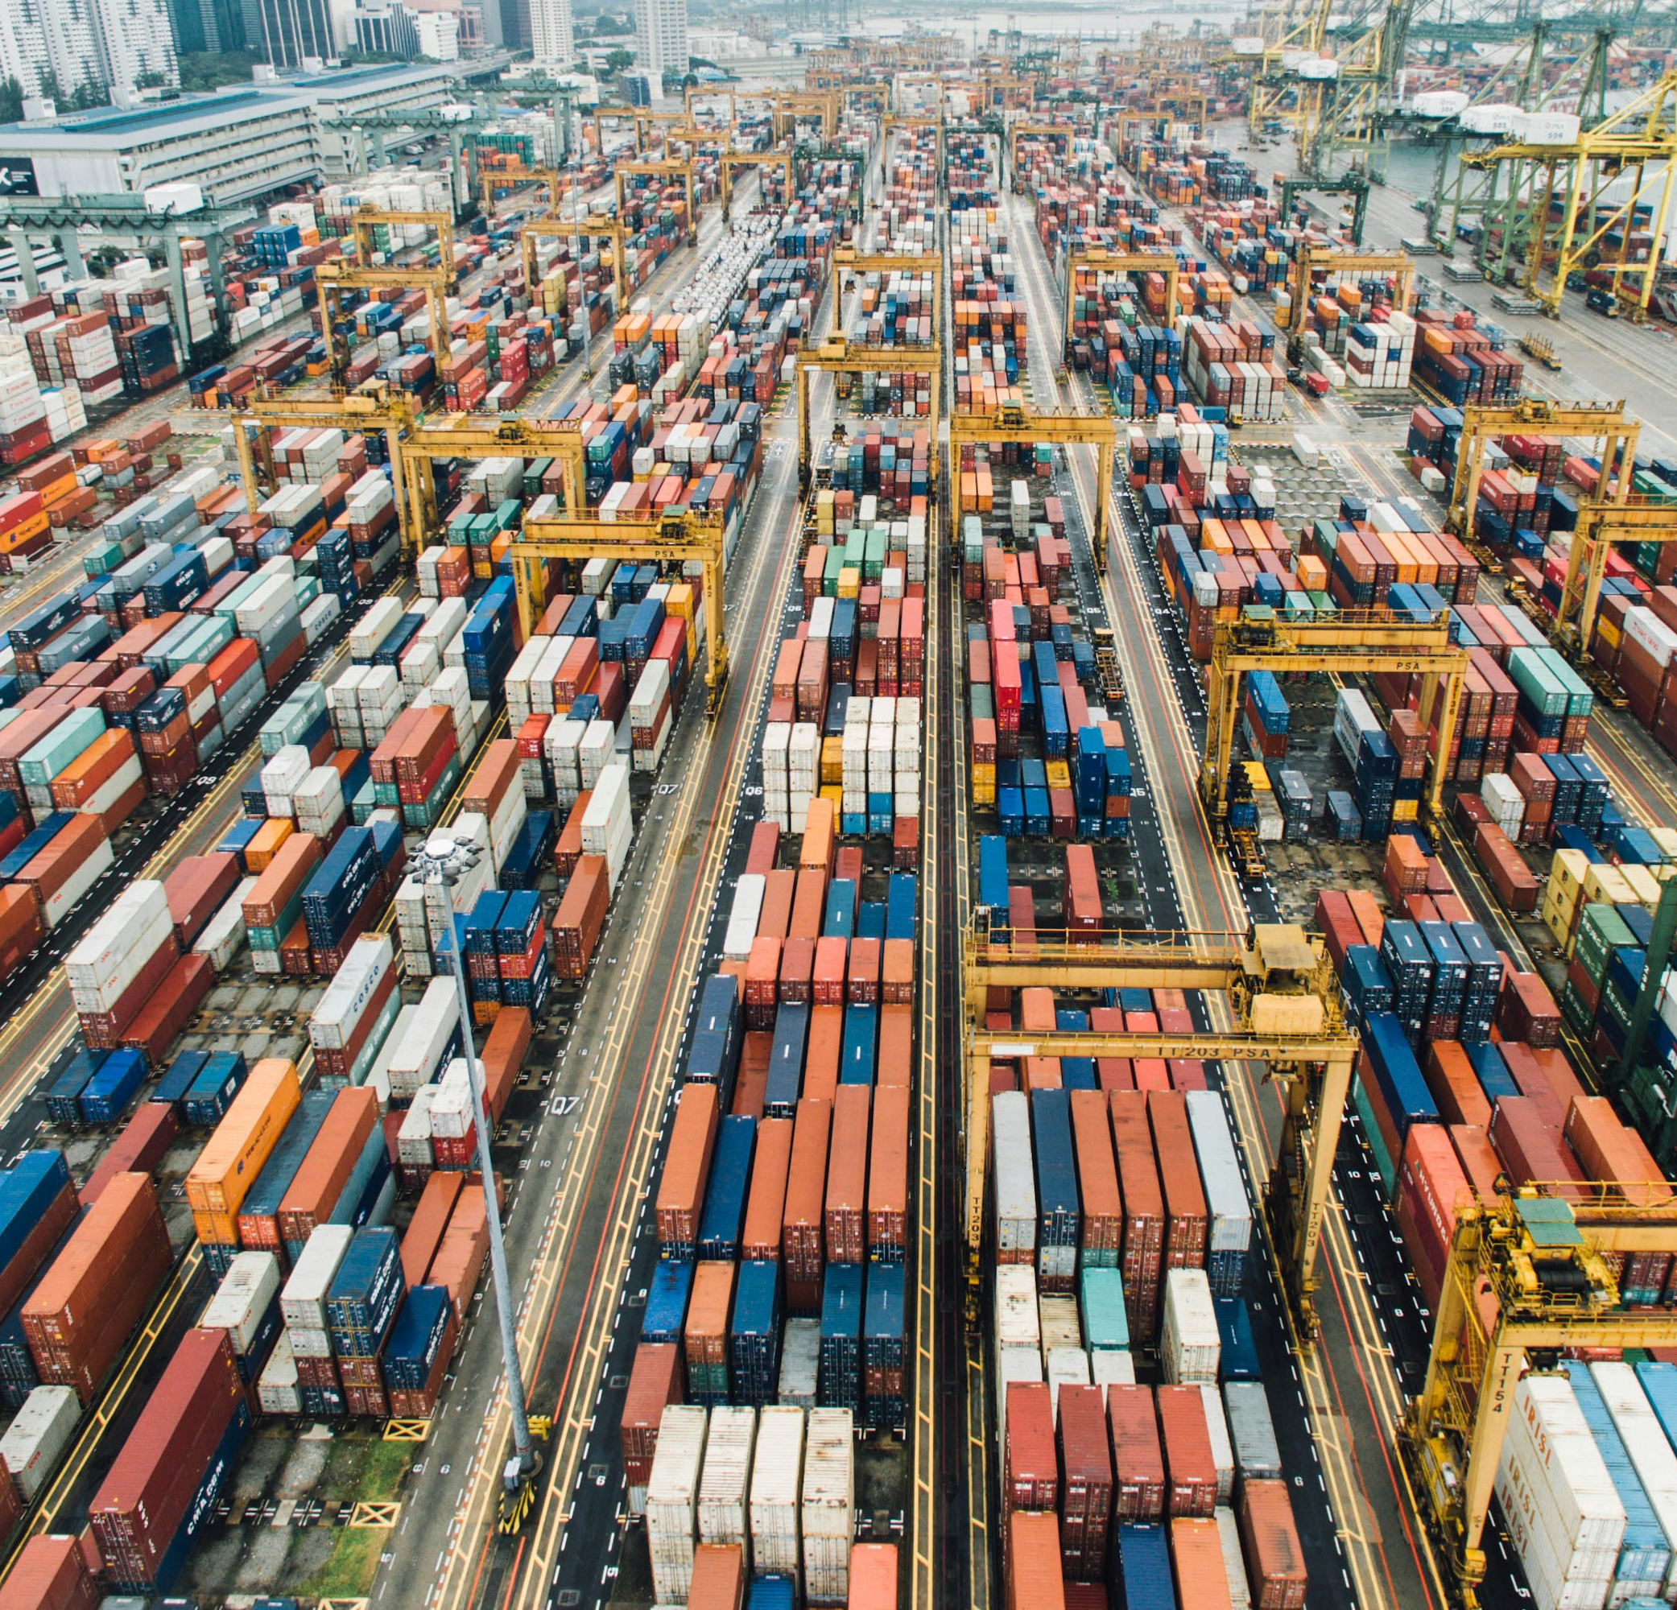



Vision 2030: Ambition for Industry
Powering trust in data
for everyone everywhere
Market access and product listing
Operational efficiency across supply chain
Consumer experience and Patient safety
Sustainability and circular economy
Companies of all sizes can seamlessly reach markets and list products globally, relying on trusted GS1 identification, registries and product data standards.
Businesses enhance supply chain visibility, efficiency and resilience in global trade, leveraging GS1 standards and services to gain instant access to trusted product data.
Billions of consumers have instant access to the story behind each product, whether shopping online or scanning a 2D barcode powered by GS1.
Patients benefit from improved safety and better outcomes as healthcare products carry a 2D barcode, scanned and used at point of care and across the supply chain.
Companies can comply with sustainability and regulatory needs while supporting the circular economy across global value chains, using GS1 standards and services for efficient product traceability.

Slide 5


Capabilities: global view
 | Data Upload |  |  | Data Usage
 | Licence Registry | GTIN Registry | GLN Registry | Verified by GS1 queries
Total | 12.9M | 712M | 2.4M | 12.8B
Connected MOs | 118 | 109 | 60 | 110
Status as of 7 October 2025
Notes:
There is an African Proverb which says, If you want to go fast, go alone. If you want to go far, go with others."
I am once again feeling this truth right up close. Our mission—standardization—is not a sprint, it's a marathon, and we can only win it together. Alone, we might achieve small improvements, but the major efficiency leaps across company boundaries only succeed through teamwork. It’s about speaking a common language so that innovation and progress can flow freely. Her how the GS1 Federation Broke a significant Data Silo.

Slide 6





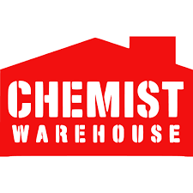




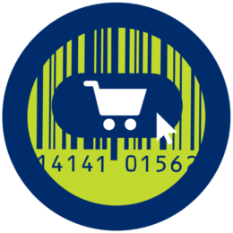


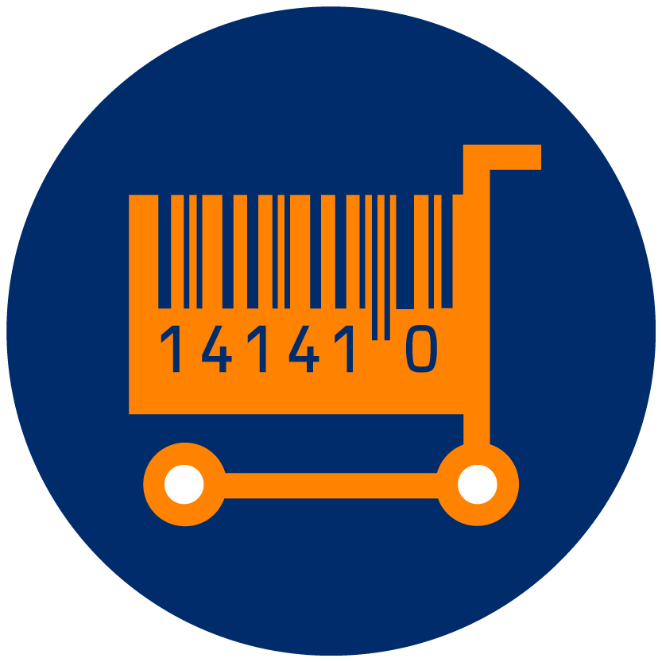




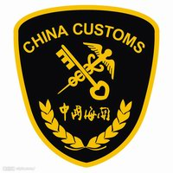




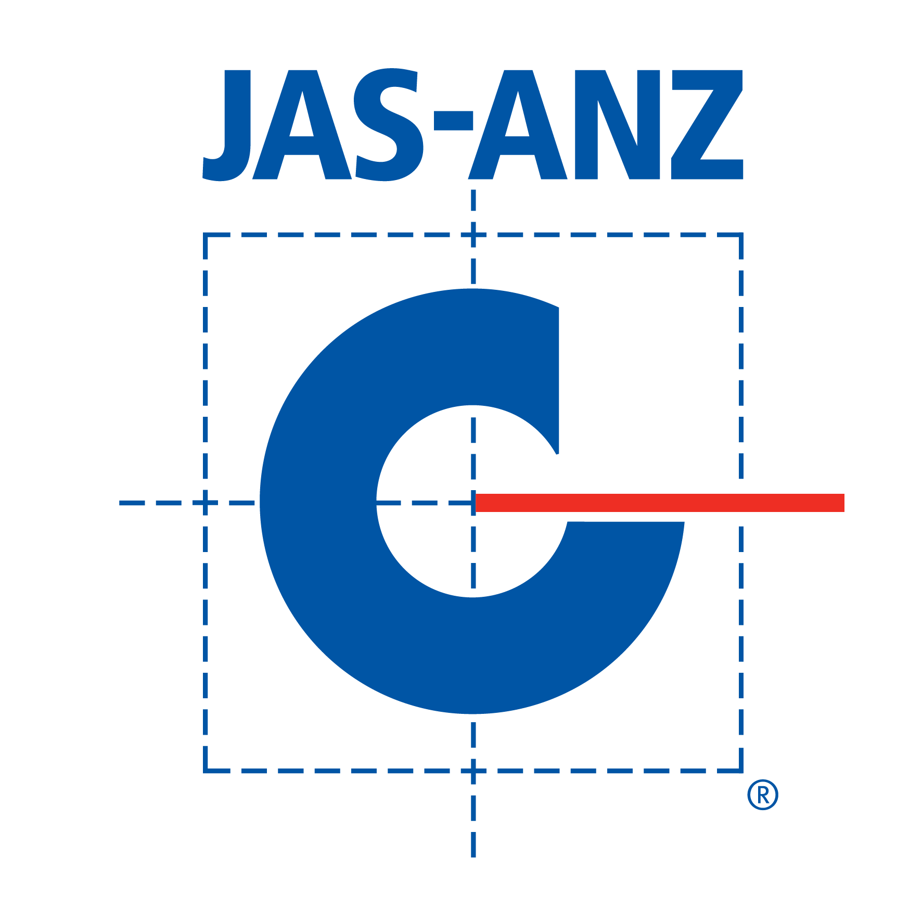

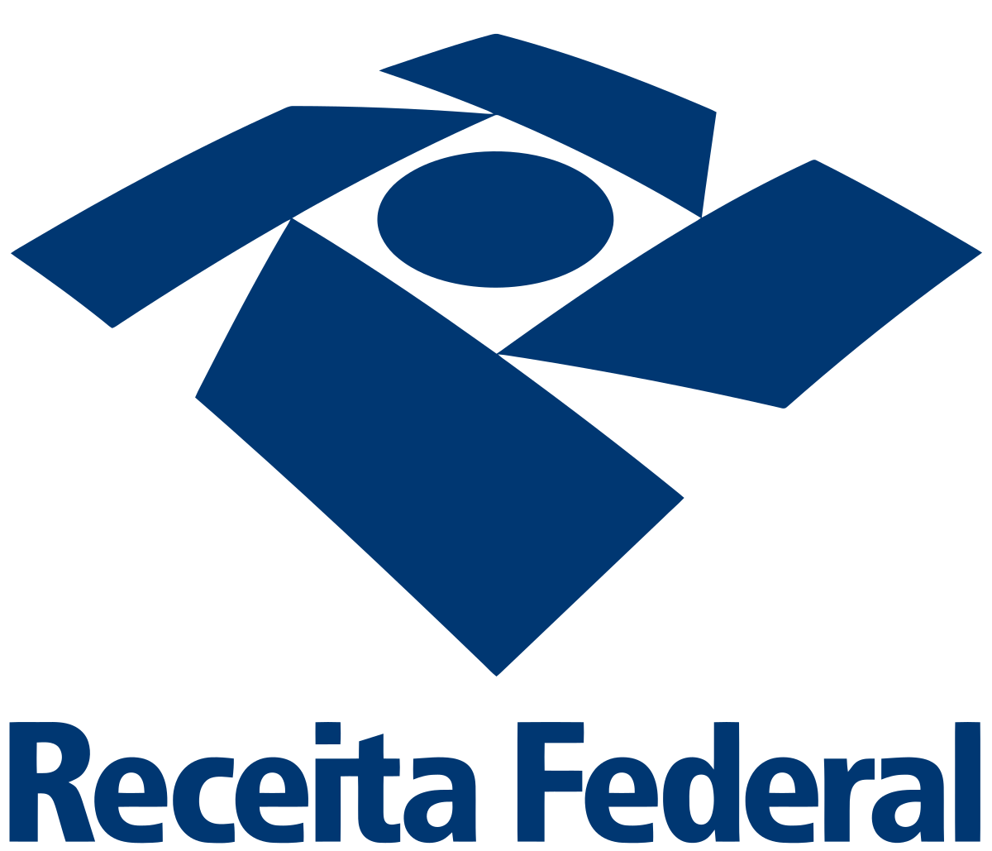


GS1 Registries Use Cases Dashboard update as of September 2025
GS1 key verification access to basic information about GS1 identifiers to ensure integrity of the GS1 system
Access to enriched product master data access extended, authoritative and trusted product master data to enable scale across markets and unlock overall efficiency gains.
Active pilots/
implementations
Sector Relevance
Industry Participants*
Active pilots/
implementations
Sector Relevance
Industry Participants*
35
11
Customs & trade digitalisation access data around GS1 identifiers to verify products and entities to increase efficiency and improve risk management at the border.
Certifications, claims & traceability
access trusted certification details of suppliers to effectively ensure product compliance and build consumer trust.
Active pilots/
implementations
Sector Relevance
Industry Participants*
Active pilots/
implementations
Sector Relevance
Industry Participants*
10
16
*Non-exhaustive

Slide 7










China Africa Co-operations
Benefits
Product identity, Data sharing & Verification
—> Trusted consumer goods trade
Improve customs
clearance efficiency
Promote the circulation
of high-quality products
Facilitate access to China-Africa trade product inquires
Enhance the consumer experience
Enhance awareness and
product publicity
Build trust in international supply chain

Slide 8
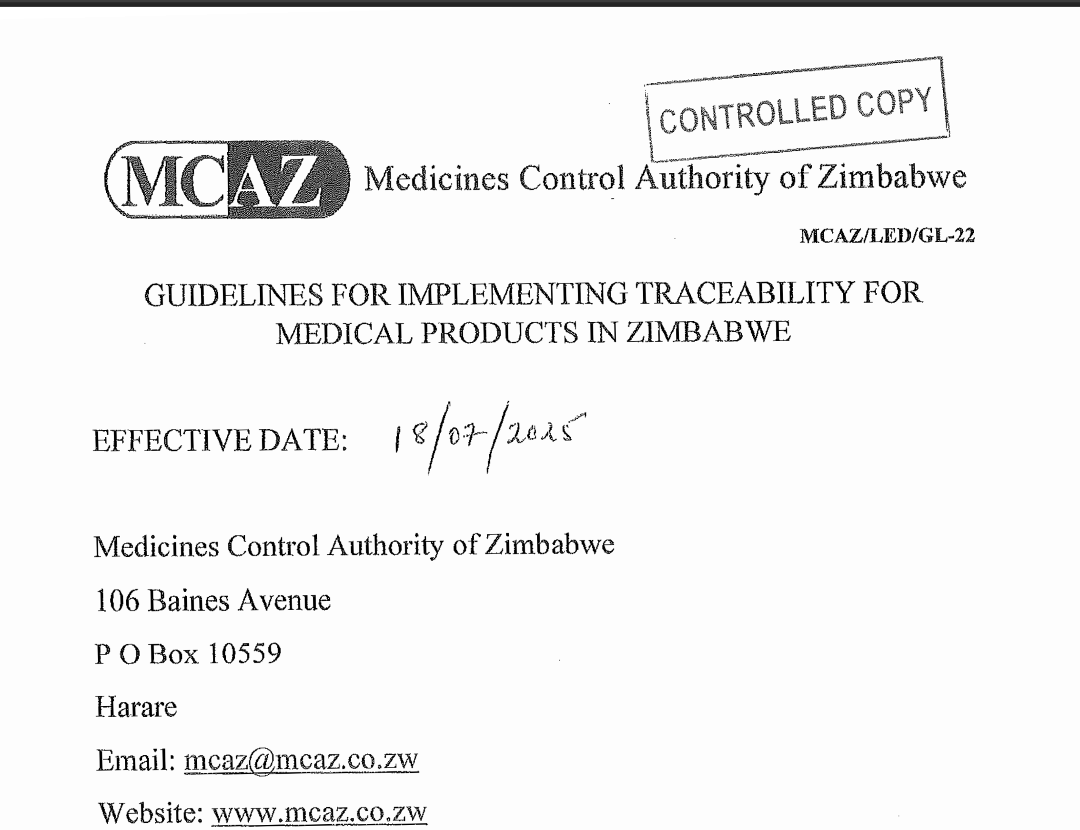



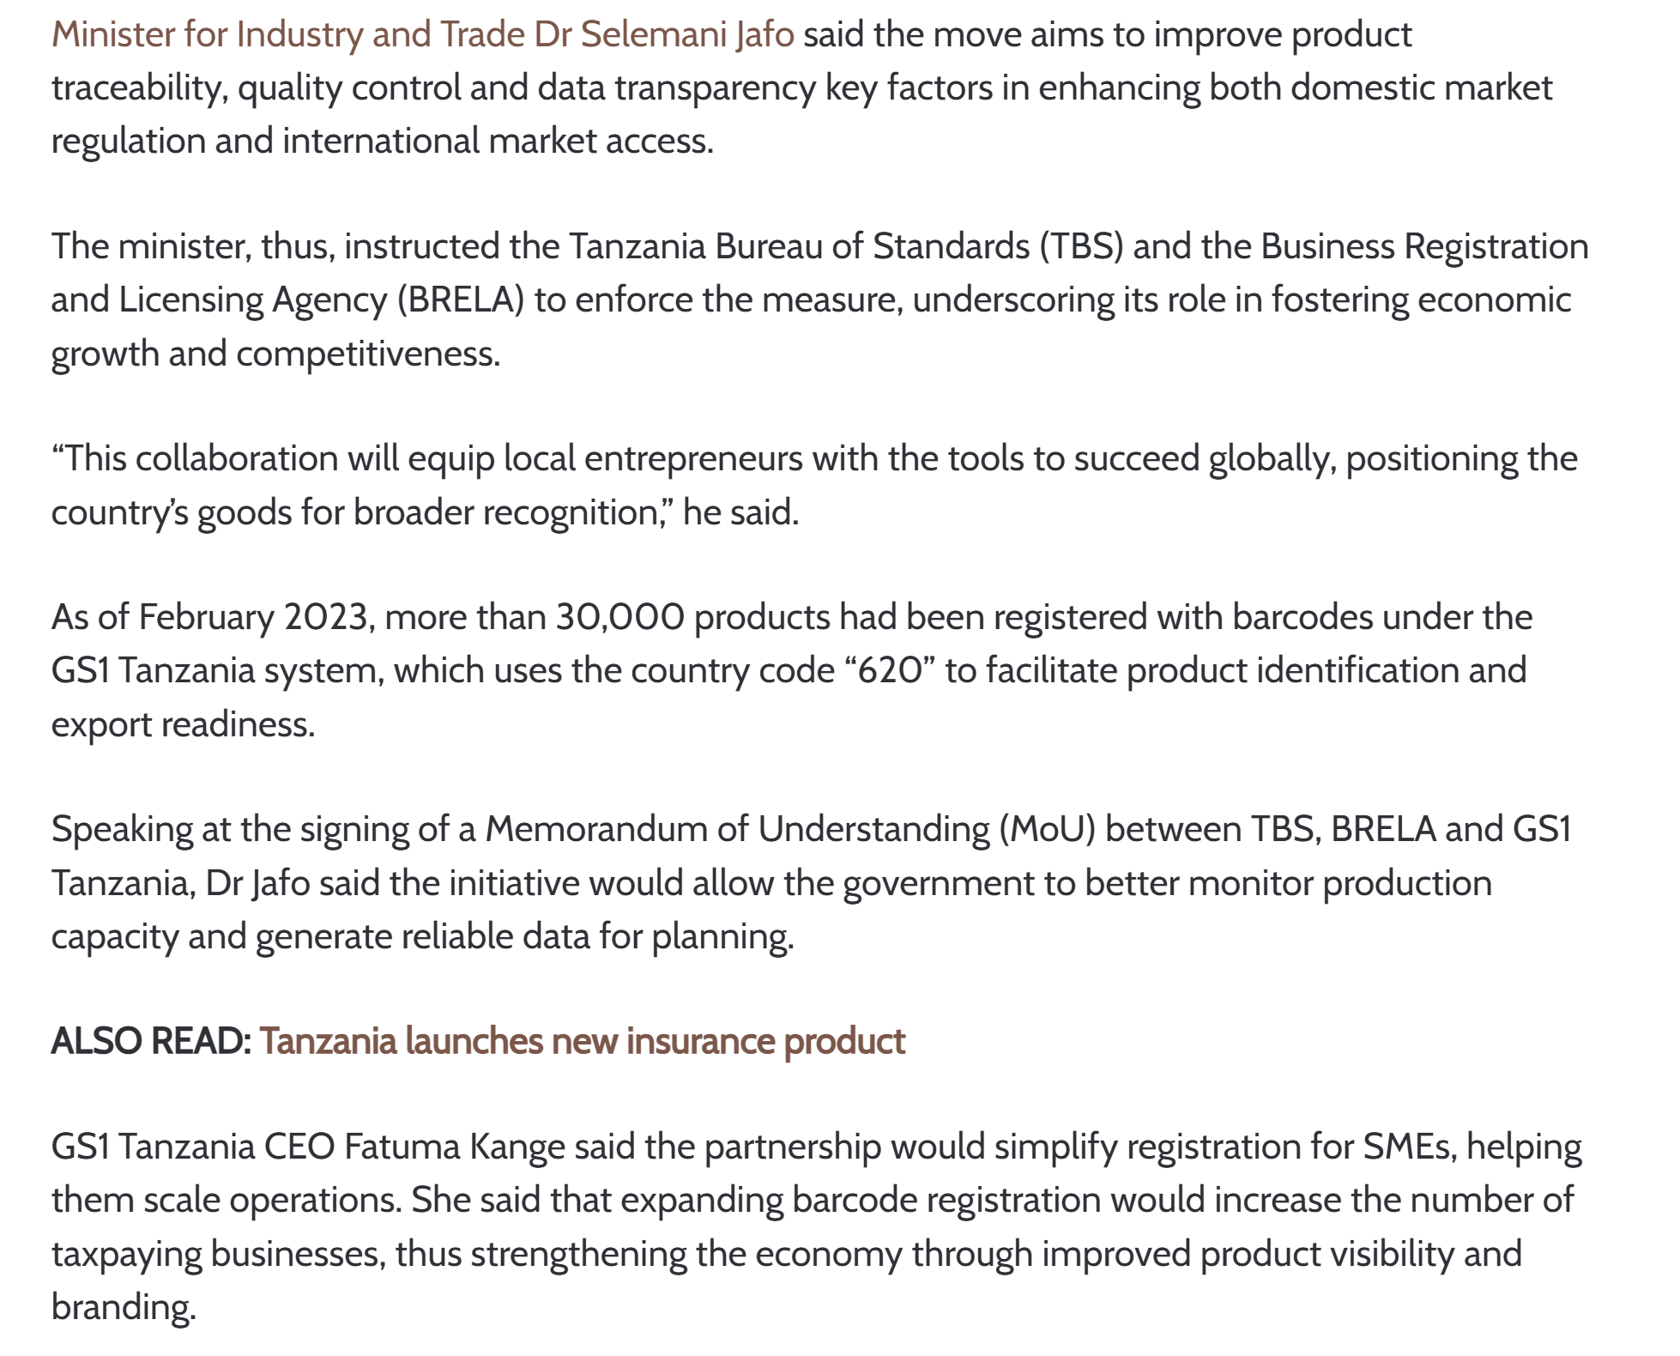
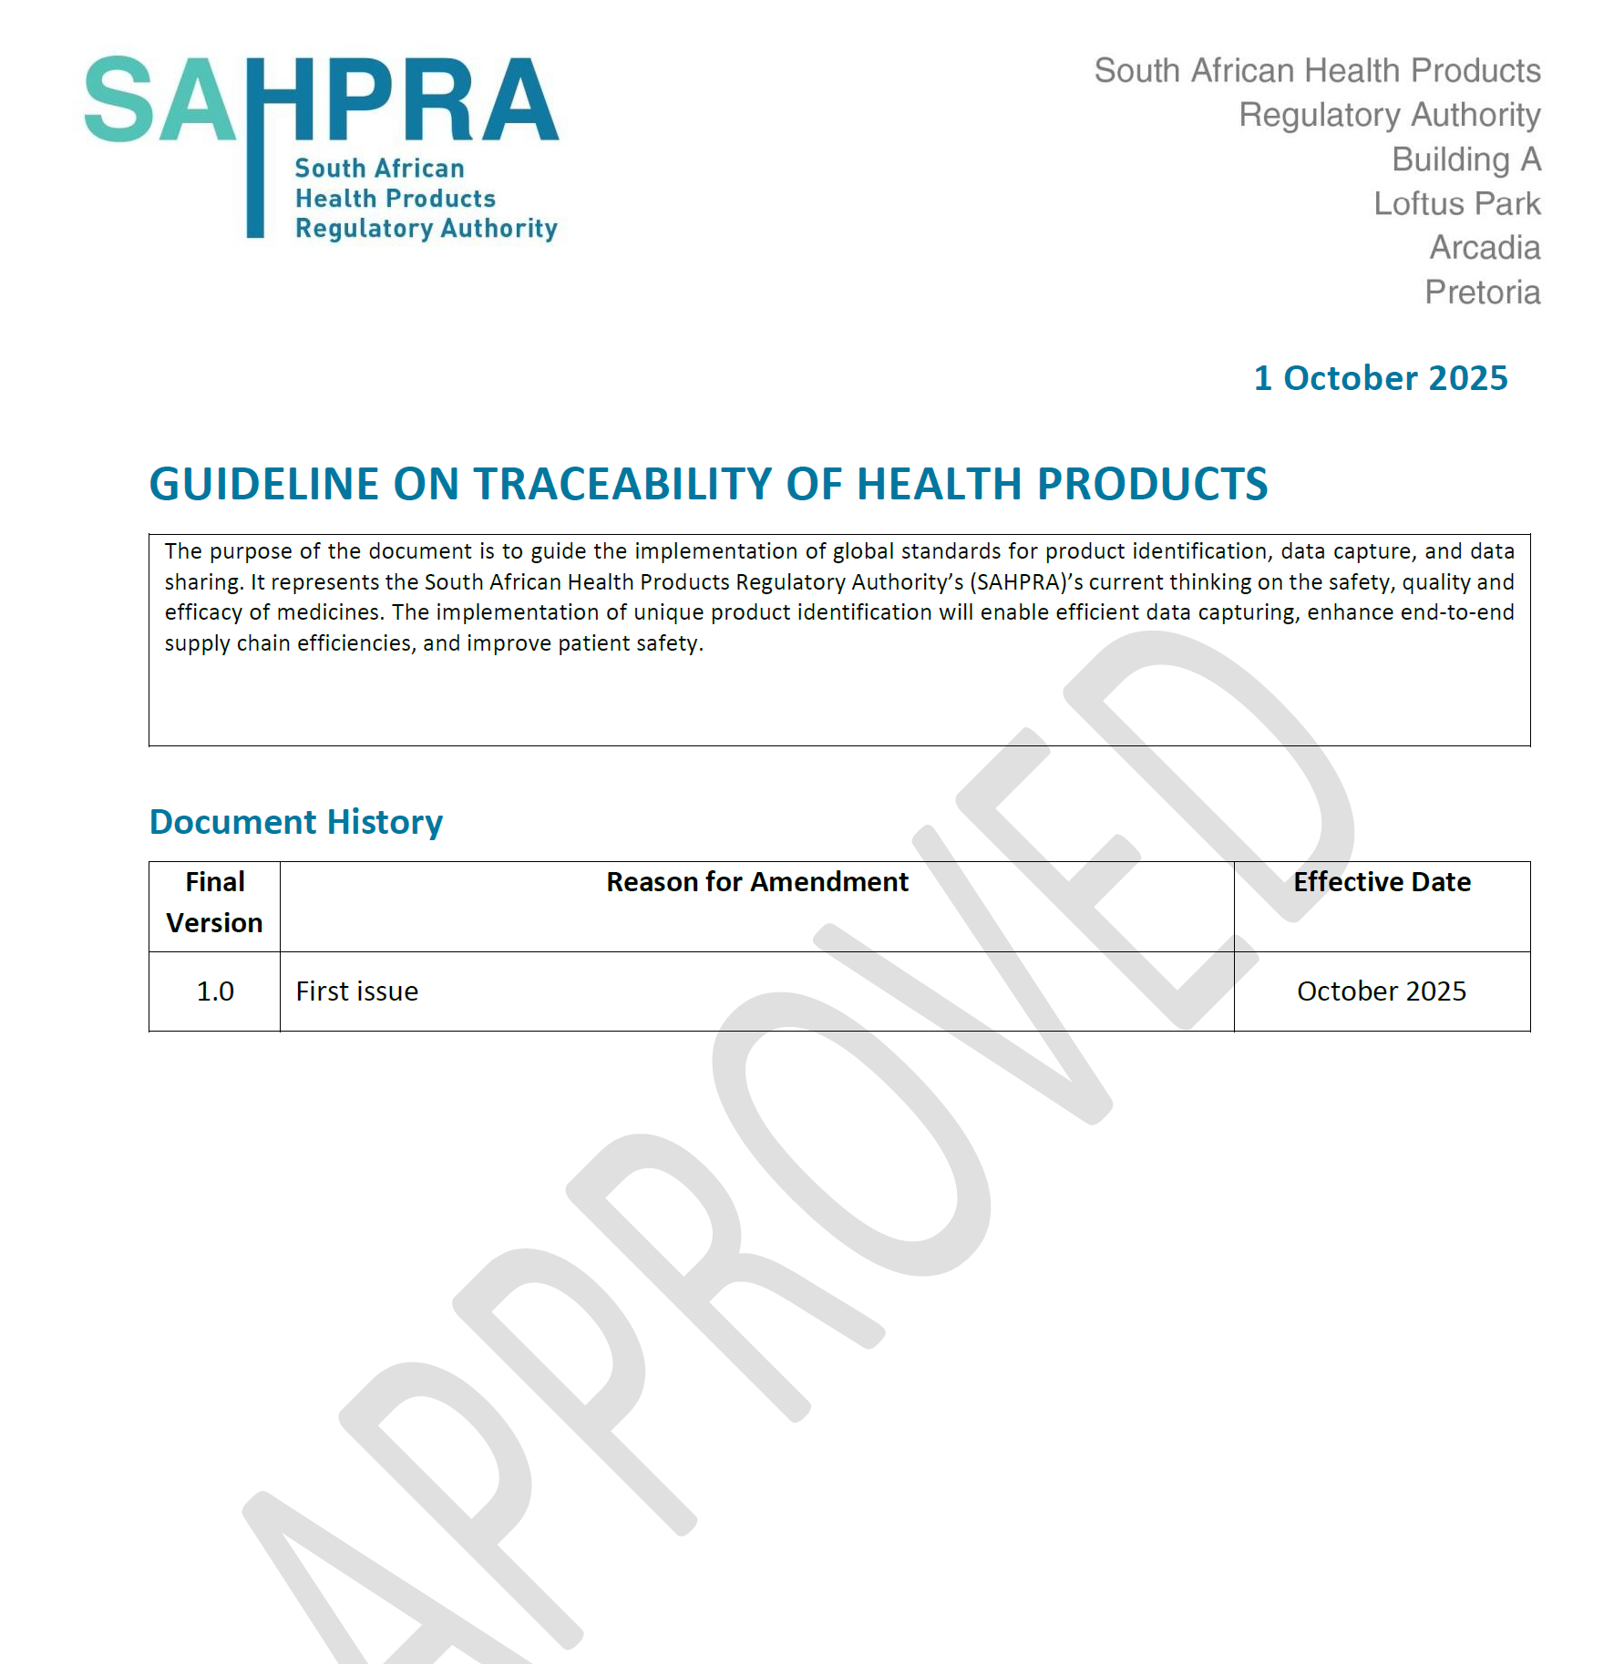
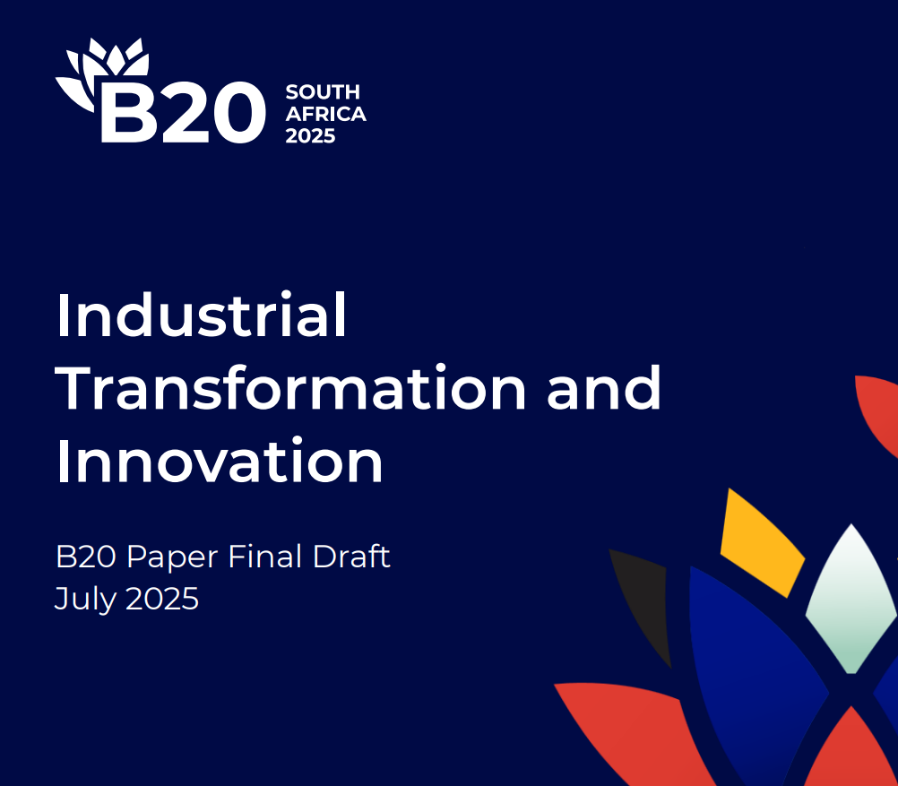
Public Policy Focus

Slide 9


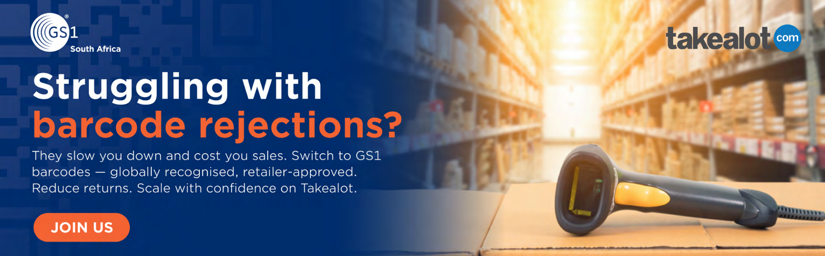
Collaboration is Key

Slide 10
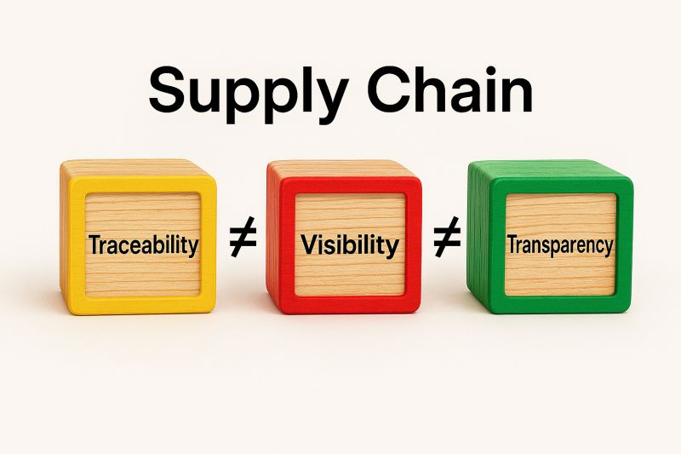
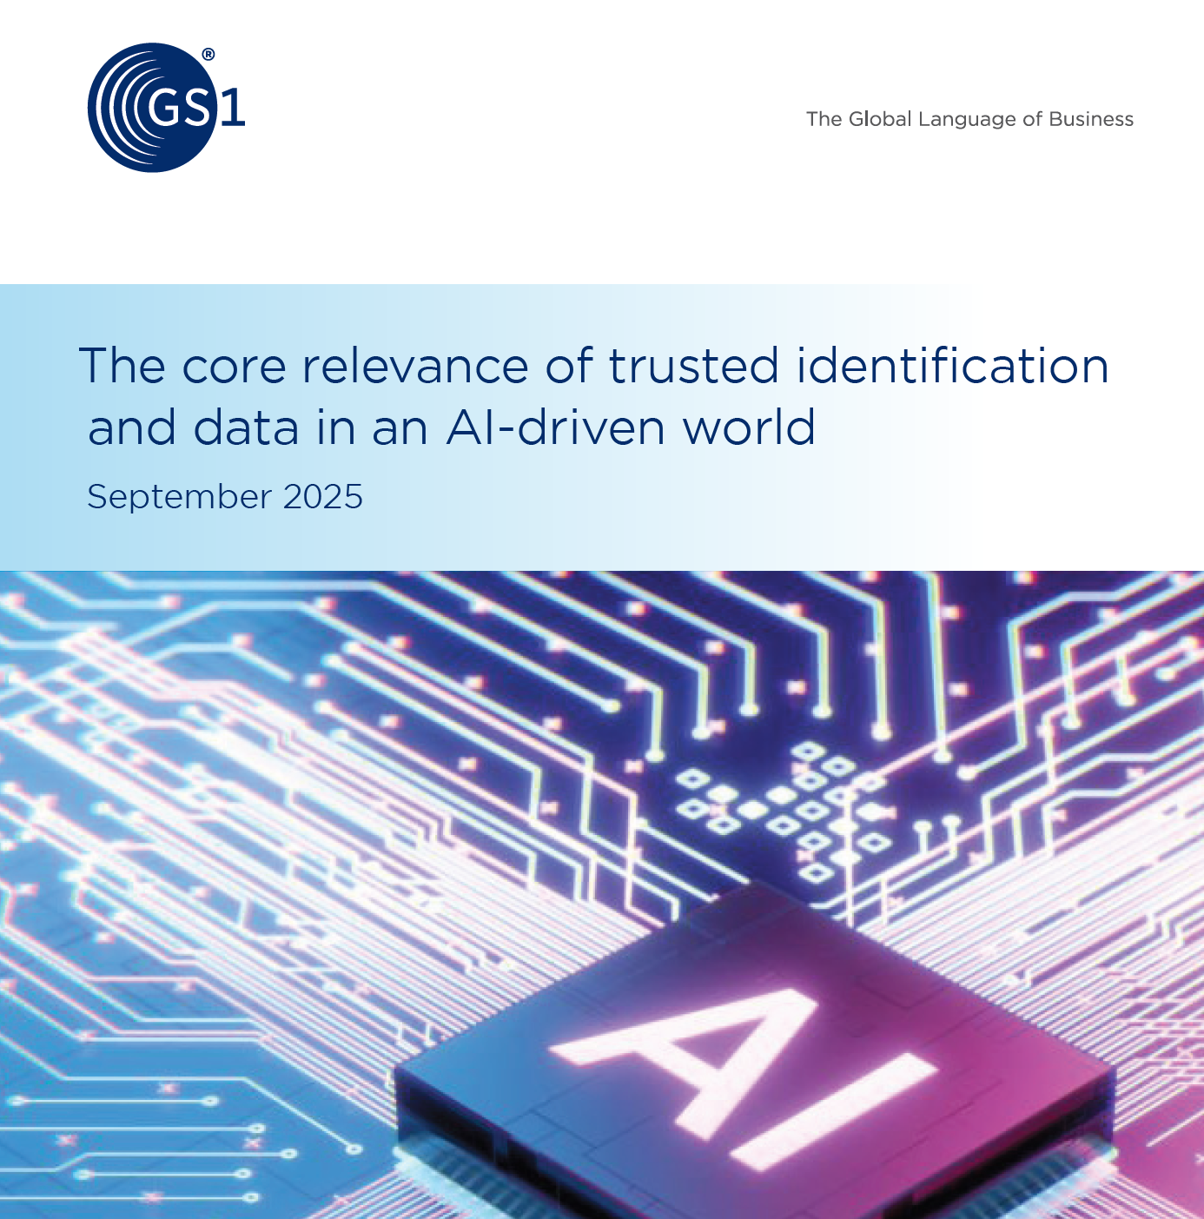
Notes:
The fact that a system that does not produce an accessible traceability audit trail is not a traceability system! Guess that requires some explanation for people to understand! Does it make sense to talk about traceability across a supply chain if there is no traceability audit trail? Certainly not. If product items are marked with globally unique identities and there is no access to a traceability audit trail, the only useful next step is to verify or authenticate the globally unique identity against a trusted database to establish origin. Establishing origin and product type, and perhaps also product attributes, in this way does not explain how it progressed to where it is currently located. Hence, the system that enables this activity cannot be called a traceability system. Instead it is a verification system. Verification and authentication of product items, logistics entities, organisations, item handling events and product attributes are important aspects of supply chain traceability. However, verification of product items is not traceability.
art 4: Traceability, Visibility & Transparency – Building the Visibility Stack Terminology Series on Supply Chain Visibility In supply chain discussions, terms like traceability, visibility, and transparency are often used interchangeably—but they serve distinct purposes. 📌 Traceability is commonly defined as the ability to identify, track, and trace the history, location, and application of products, parts, or materials. It’s essential for sustainability and ethical sourcing—but in a supply chain context, it offers limited visibility. Traceability exists as an audit trail linked to participating organisations. It doesn’t tell us: •⁠ ⁠Whether product and process attributes meet agreed standards •⁠ ⁠If regulations and best practices are being followed •⁠ ⁠How supply and demand are coordinated across the chain 📊 That’s where visibility comes in. Visibility adds layers of data specific to: •⁠ ⁠Product and process attributes •⁠ ⁠Compliance with standards and regulations •⁠ ⁠Supply-demand coordination •⁠ ⁠Regulatory compliance oversight and fiscal incentives design These layers, combined with traceability, form the visibility stack—tailored to the specific needs of a supply chain programme and shared internally up to retailers. Increasingly, it makes more sense to talk of a visibility audit trail rather than just a traceability audit trail. 🌍 Transparency, on the other hand, refers to sharing selected visibility data with external parties—typically consumers and regulators. It generally focuses on ethical practices, sustainability, and accountability.

